Slide 2
Fairleigh Dickinson University
Founded in 1942 to be a university ‘of and for the world’
Independent, not for profit
Vancouver Campus founded in 2007

Slide 3
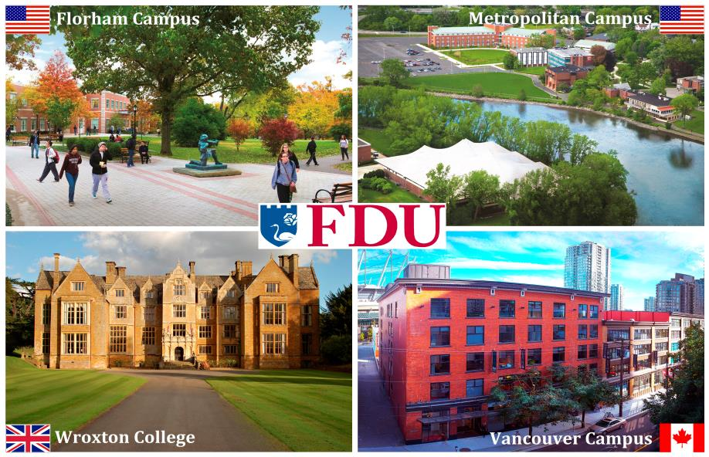
Four International Campuses
Notes:
Undergraduate students who start in Vancouver campus can do a visiting semester in New Jersey and/or Wroxton (U.K) Campus.

Slide 4
Student Body
Approximately 900 students on the FDU Vancouver Campus
Over 79 countries represented

Slide 5
Approvals and Rankings
EQA
Education Quality Assurance by the Ministry of Advanced Education British Columbia
AACSB
International Association to Advance Collegiate Schools of Business
The Princeton Review Best 295 Business Schools 2016
Top 10 Hospitality Program in the U.S

Slide 6
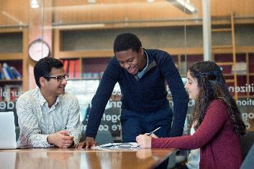
Bachelor of Science in Business Admin.
AACSB accredited
Top 5% business school worldwide
Concentration in International Business
*NEW* Minor in Digital
Marketing
121 credits
60 can be transfer credits

Slide 7
Bachelor of Science in IT
Total of 122 credits
60 credits can be transfer credits
Minor in Business Administration
Great balance of Design components, Coding & Programming and Network administration.

Slide 8
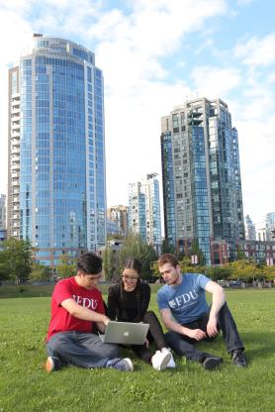
Bachelor of Arts in Individualized Studies
Specializations in:
Business
Communication
Applied Technology
Hospitality and Tourism Management
International Relations
Total of 120 credits
90 credits can be transfer credits

Slide 9
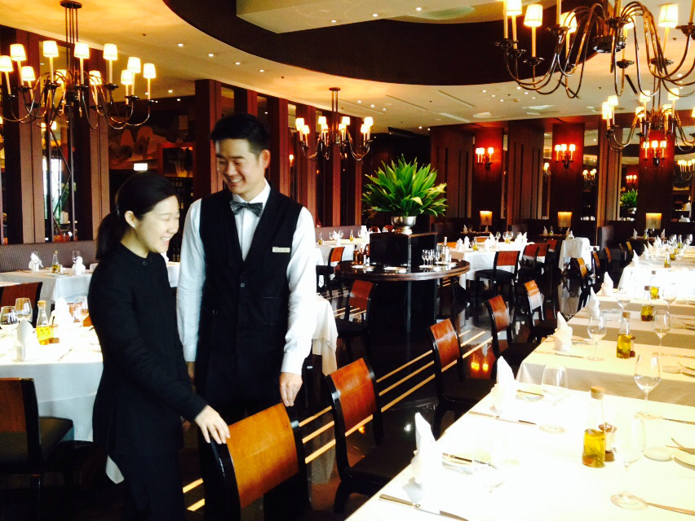
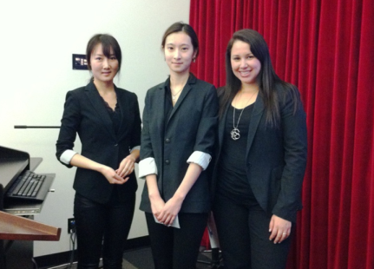
B.A.I.S Specialization in Hospitality and Tourism Management
“…A great life experience, looking at the big picture and planning for my future…”
Michelle Kim – Fairleigh Dickinson University – Vancouver Campus
Project on a New Boutique Hotel Concept in Vancouver
HRTM2210 – Sales and Marketing Hospitality Managers

Slide 10
Transfer Credit
It is possible to transfer credits from the BCCAT system as well as overseas universities and colleges.
The final grade of the transfer course must have been ‘C’ or higher
For year one and two transfer credit courses can be general education requirement courses
For upper level courses the transfer credit course must have the same course content as equivalent FDU required courses

Slide 11
ESL Pathway Schools
VGC www.vgc.ca (level 7)
ELS www.elscanada.com (level 110)
Kaplan International https://www.kaplaninternational.com/canada (level B2)
ILSC www.ilsc.com (Level i4)
Vanwest College www.vanwest.com (level 7)
ILAC www.ilac.com (level 14)
Inlingua Vancouver www.inlinguavancouver.com (level 4A)
ISS of BC http://lcc.issbc.org/ (Intensive English 7)
EC http://www.ecenglish.com/school-locations/learn-english-in-vancouver (High-intermediate)
Global Village http://gvenglish.com/ (level 8)

Slide 12
Pre-University Program - PUP
Who would Qualify for Pre-University Program?
For students who have IELTS 5.5 level or TOEFL 69
For students who score below 15/18 on FDU Vancouver Placement test
For students who have completed designated ESL Pathway level.
Pre-University Program (PUP)
Two academic English courses (no degree credit)
2-3 credit-bearing courses
Math/IT/English for Professional Success
Tuition for PUP courses: US $ 2,100

Slide 13
Scholarships and Tuition
As a not for profit, every accepted FDU student will be awarded a scholarship.
Scholarships value is from $14,640 - $73,320* for four year bachelor programs
Apply for 15-50% of your tuition cost to be reimbursed with your academic performance
Freshman apply for 65-75% of your tuition cost to be reimbursed with a strong SAT score and high academic achievement
*Higher bracket of scholarship are only applicable to Freshman students.

Slide 14
Scholarships and Tuition
Regular Tuition fee per Credit: US $814
Annual tuition fee without scholarship (30 credits):US $ 24420
 | Freshmen + Transfer Students |  |  |  |  | Freshmen
 | Based on Academic merit |  |  |  |  | **SAT score + Questionaire
 | Study Grant | Global Scholarships (GSP application needed)
 |  | Provost Scholarship |  |  | Colonel Fairleigh S. Dickinson Scholarship (BSBA,BAIS)
 |  | Gregory H. Olsen Scholarship (IT)
Scholarship Per Credit | $122 | $204 | $285 |  | $407 | $529 | $611
Scholarship per Academic Year (30 credits) | $3,660 | $6,120 | $8,550 |  | $12,210 | $15,870 | $18,330
Scholarship for entire Bachelor program (based on 120 credits) | $14,640 | $24,480 | $34,200 |  | $48,840 | $63,480 | $73,320
Yearly Tuition to be paid Based on 30 credits | $20,760 | $18,300 | $15,870 |  | $12,210 | $8,550 | $6,090

Slide 15
Scholarships and Tuition
Scholarship ranging from 15% to 50%:
No separate scholarship application needed
Will be based on academic performance, transfer credits and recommendation letters
Scholarship ranging from 65% to 75% (only for Freshman students):
Please fill out Global Scholars Program Application and send in answers to questionnaire on the Global Scholars Program Application.
Will be based on academic performance, recommendation letter and SAT score (combined score of critical reading and math sections)
Combined mark of 1180 and over can be eligible for maximum 65% entrance scholarship
Combined mark of 1280 and over can be eligible for maximum 75% entrance scholarship

Slide 16
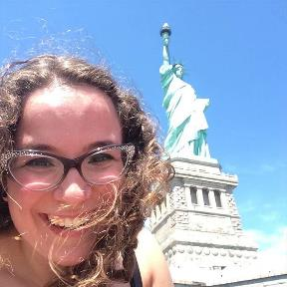
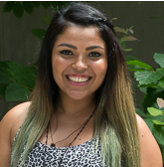
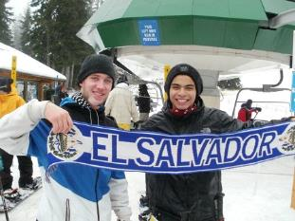
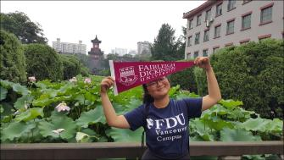
FDU Study Abroad Options

Slide 17
United Nations Relationship
Fairleigh Dickinson University has been granted “special consultative status” with the United Nations
One of the first universities designated as an official NGO of the UN
FDU Vancouver Campus works with the United Nations Association of Canada

Slide 18
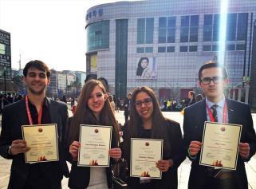
Global Scholars Program
Our Global Scholars program allows students access to United Nations and UN-related:
seminars
internships
lectures
receptions

Slide 19
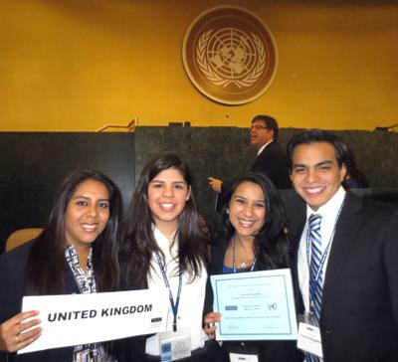
NMUN Distinguished Delegation
Awarded Distinguished Delegation at the 2014 National Model United Nations in New York

Slide 20
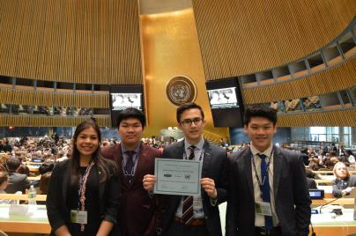
National Model UN 2016
4 FDU Vancouver Students participated in National Model U.N in New York City and our students, Peter Mate and Viet “Lucky” Truong won the Outstanding Delegation Award in their Habitat III Committee, as voted by their peers at NMUN 2016.

Slide 21
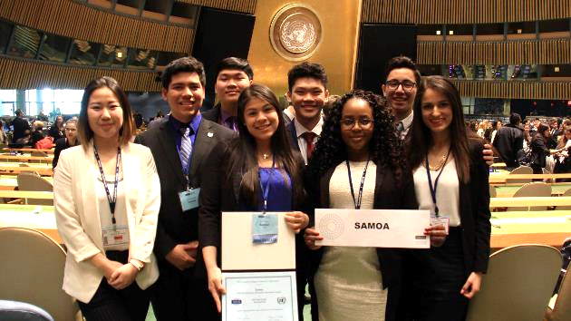
National Model UN 2017
FDU’s largest team ever, wins yet another Distinguished Delegation Award at 2017 National Model U.N in NYC!

Slide 22
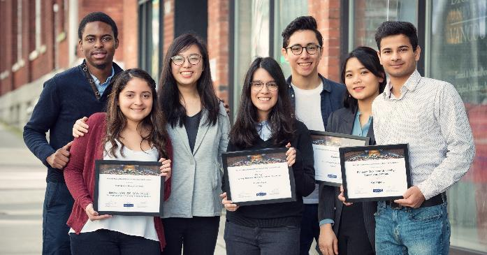
National Model UN 2018
This year, FDU’s team wins 3 awards (Outstanding Delegate/ Distinguished Delegation/ Best Position Paper) at 2018 National Model U.N in NYC!

Slide 23
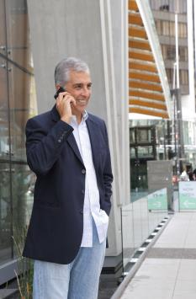
Master of Administrative Science
Program Specializations:
Human Resources Administration
Global Technology Administration
Emergency Services Administration
Global Leadership and Administration
Computer Security and Forensic Administration
Global Health and Human Services Administration
Total of 30 credits + 1 Research Foundation
9 credits can be transfer credits upon review
Total Tuition
USD $ 28,350

Slide 24
Pre-MAS
For students who have IELTS score of 5.5 level or TOEFL 69 and a FDU Placement test of 11.5-15/18
One semester program (15 weeks approx.)
Pre-MAS Fee: US $2,100
Students will take:
2 non-credit bearing Academic English Courses
1MAS course

Slide 25
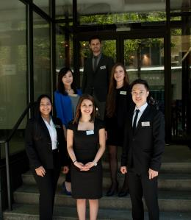
Master of Science in Hospitality Management Studies (MSHMS)
Program Highlights
One of the oldest and prestigious International Hospitality programs in the U.S.
Outstanding faculty of industry professionals
Total 33 credits / maximum 6 credits can be transferred upon evaluation
USD $925 per credit
USD $30,525 for MSHMS
Foundation Courses 1&2(for students with limited Hospitality background – will be part of 33 credits)
Special Project: USD $600

Slide 26
Master of Science in Hospitality Management Studies (MSHMS)
Admission Requirement
4-year bachelor's degree with a minimum CGPA of 2.75
Three years of industry experience.
(applicants with less than 3 years of industry experience may be required to take prerequisite courses upon evaluation)
Statement of Purpose
2 Letters of Recommendation
IELTS 6.0 or TOEFL 79 (pre-master program available for students in IELTS 5.5/TOEFL 69 range)
Optional Personal interview
Resume or portfolio

Slide 27
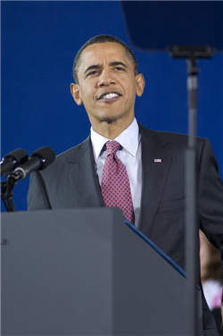
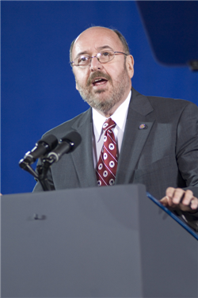
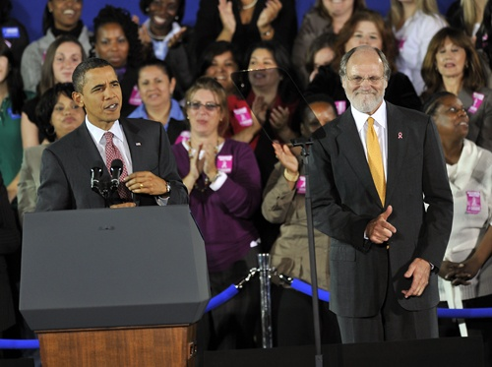
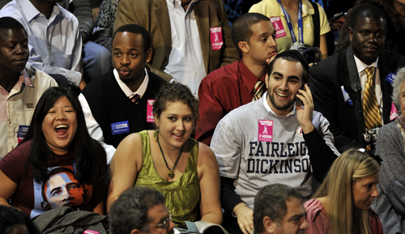
President Obama’s Visit to FDU NJ

Slide 28
FDU Alumni
Dennis Strigl MBA ’79
Former President and COO, Verizon Communications
Ki-Moon Ban Honorary
UN Secretary General
Jeong-eun Hyun MA ‘83
Chairwoman, Hyundai Group
Ronald M. Brill BA
Co-founder, Home Depot

Slide 29
Student Activities
Longboat Competition
Soccer
Volleyball
Model U.N Club
Shoreline Clean-up
Vancouver Whitecaps Game
Cricket Team

Slide 30
Leadership Opportunities
Diplomatic Speaker Series
UN Pathway Seminar
#1 in Langara Marketing Competition
Guest Speakers
Toastmasters Club

Slide 31
Career Opportunities
Career Fair
Resume Writing Workshop
Rotaract Club
Career Services Manager
Online Career Resources

Slide 32
Canadian Work Permits
Students are eligible to work Off-Campus
Allows you to work part-time a max. of 20 hours a week
Graduates are eligible to apply for up to three year Post-Graduate Work Permit.

Slide 33
Application Process
Undergraduate Program
1. Complete Online Application
4. Copy of Passport and Study Permit (if applicable)
Graduate Program
1. Complete Online Application
2. Official Transcript from University
4. Copy of Passport and Study Permit (if applicable)
3. Two (2) Recommendation Letters
3. Two (2) Recommendation Letters
2. Official Transcript from High School or College/ University
5. IELTS or TOEFL result
5. IELTS or TOEFL result
6. Statement of Purpose

Slide 34
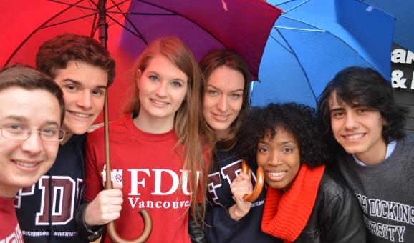
Thank You
www.fdu.edu/vancouver
vancouver@fdu.edu
Phone 604.682.8112

